Slide 1
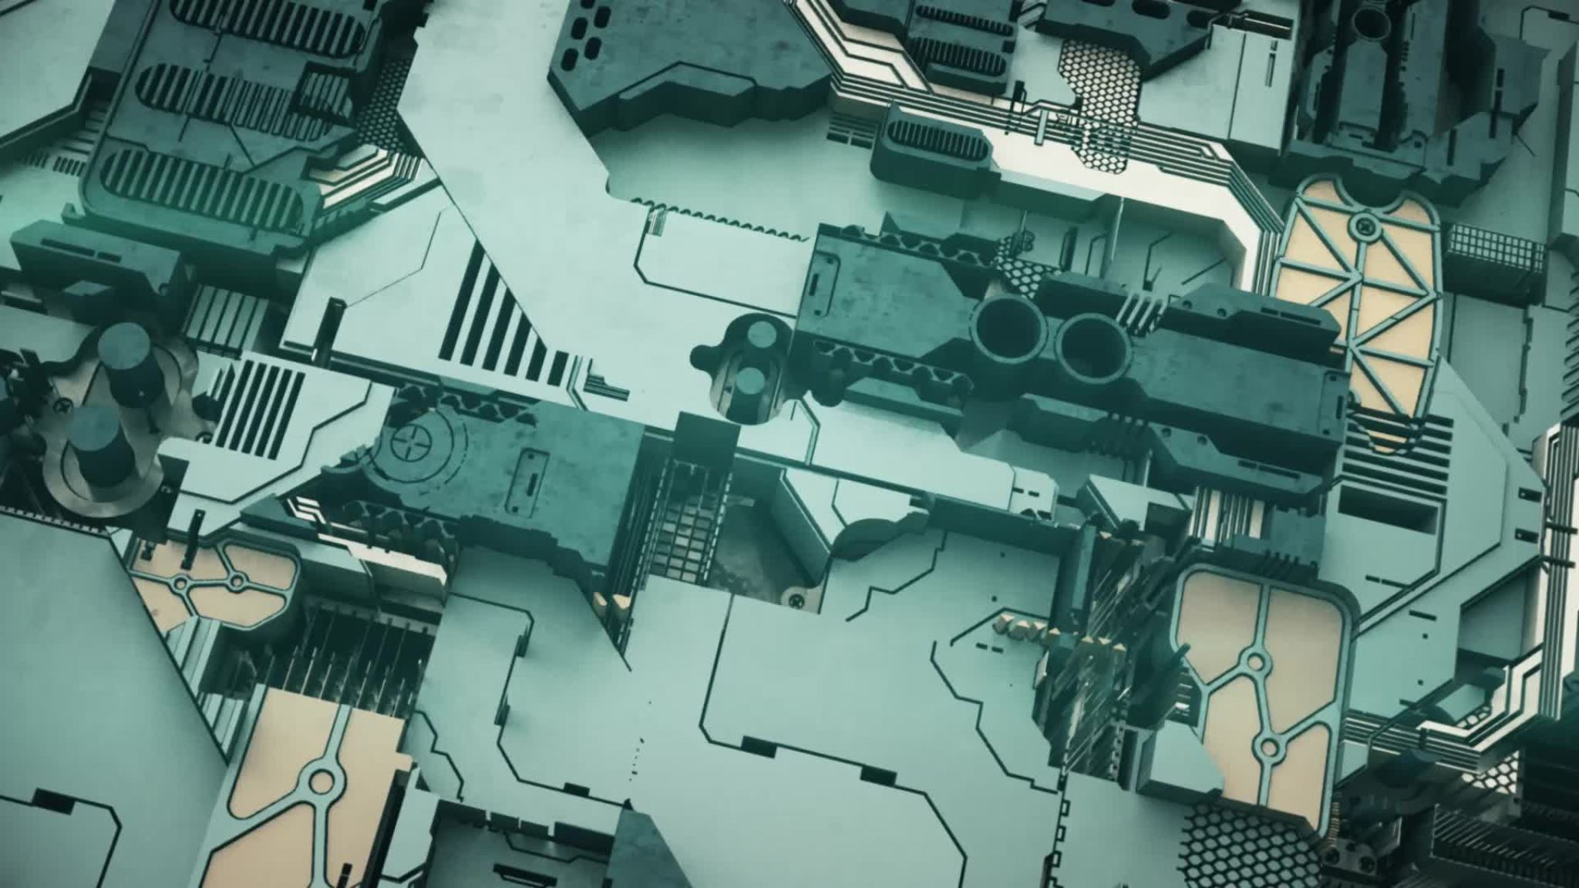

Module-1

Slide 2

Topic
What is programming?
Why learn programming?
Introduction to Command line.
Setup VSCode, Git, CodeBlocks.
Introduction to C programming.
Variables.
Data type.

Slide 3

What is programming?
Programming is the process of creating a set of instructions that tell a computer how to perform a task. It involves writing code in a programming language to solve specific problems or accomplish a specific task.

Slide 4
Binary Representation of letters and numbers.
Numbers: 0: 00110000 1: 00110001 : 00110010 3: 00110011 4: 00110100 5: 00110101 6: 00110110 7: 00110111 8: 00111000 9: 00111001
Uppercase Letters: A: 01000001 B: 01000010 C: 01000011 D: 01000100 E: 01000101 F: 01000110 G: 01000111 H: 01001000 I: 01001001 J: 01001010 K: 01001011 L: 01001100 M: 01001101...
Lowercase Letters: a: 01100001 b: 01100010 c: 01100011 d: 01100100 e: 01100101 f: 01100110 g: 01100111 h: 01101000 i: 01101001 j: 01101010 k: 01101011 l: 01101100 m: 01101101....

Slide 6
Why learn programming?
Problem-Solving Skills: Programming helps you develop logical thinking and problem-solving skills. It involves breaking down complex problems into smaller, manageable parts, and solving them step by step.
Career Opportunities: There is a high demand for programmers in various industries such as technology, finance, healthcare, and more. Learning to program can open up a wide range of job opportunities.
Automation: If you find yourself doing repetitive tasks, programming can help automate those tasks, saving you time and effort.

Slide 7
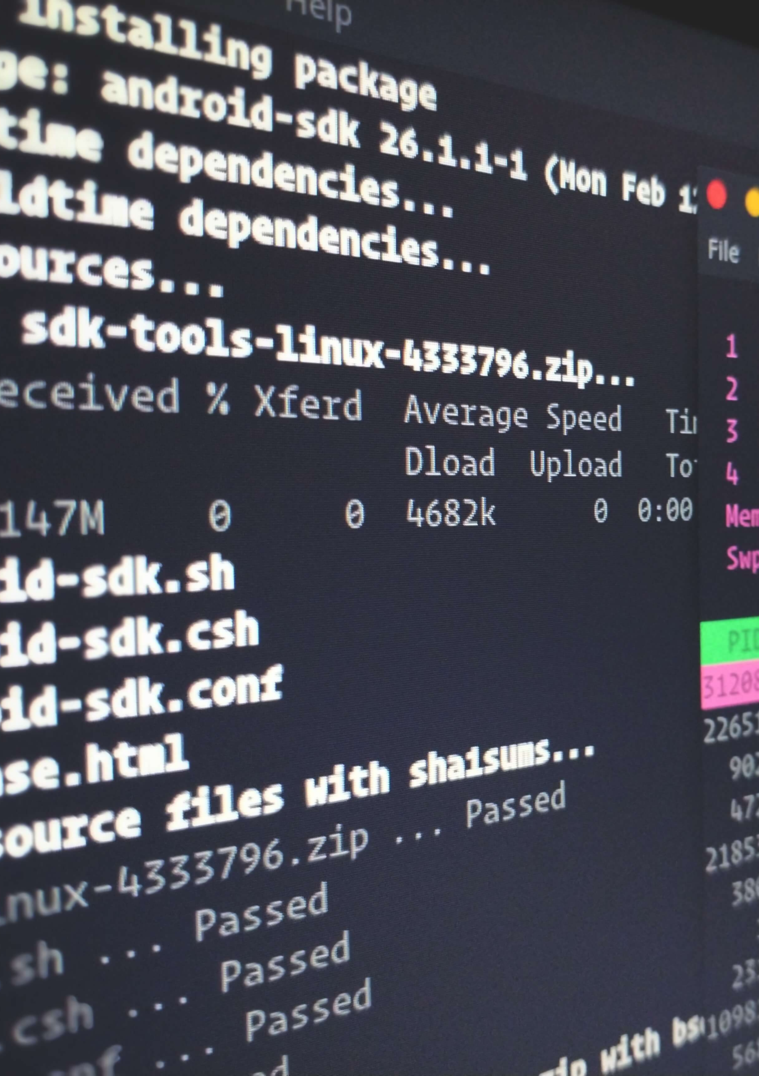
Introduction to Command line.
Command Line: The command line, also known as the command-line interface (CLI), is a text-based user interface that allows you to interact with your computer. You can enter commands, run programs, and manipulate files directly from the command line.
Terminal: A terminal, on the other hand, is a text input and output environment. It’s a program that acts as a wrapper and allows us to enter commands that the computer processes.
PowerShell: PowerShell is an object-oriented automation engine and scripting language with an interactive command-line shell that Microsoft developed to help IT professionals configure systems and automate administrative tasks

Slide 8
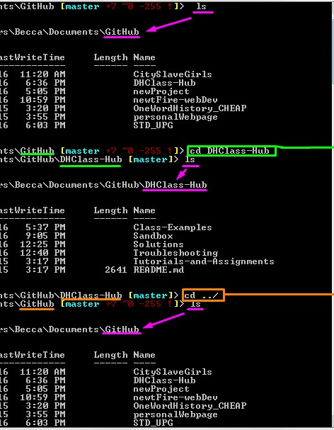
Commonly used comma line commands​​
ls: Lists a directory’s content.
pwd: Shows the current working directory’s path.
cd: Changes the working directory.
mkdir: Creates a new directory.
mv: Moves or renames files and directories.
cp: Copies files and directories, including their content.
cat: Lists, combines, and writes a file’s content as a standard output.
echo: Prints a string of text in the terminal window.
find: Search for files.
man: Show man pages.
rm: Remove a file.
whoami: Find out who you are logged in as.

Slide 10
Variable naming rules:
A variable name can consist of letters (both uppercase and lowercase), digits, and the underscore character (_).
The first character of a variable name must be a letter or an underscore.
Variable names are case-sensitive in C. For example, myVariable and myvariable are two different variables.
Reserved words (keywords) in C cannot be used as variable names. For example, int, char, float, etc.

Slide 11

Naming Conventions:
Variable names should be descriptive and meaningful, which makes the code more readable.
Camel Case:- numberOfStudents
Snake Case:- number_of_students
Pascal Case:- NumberOfStudents

Slide 12
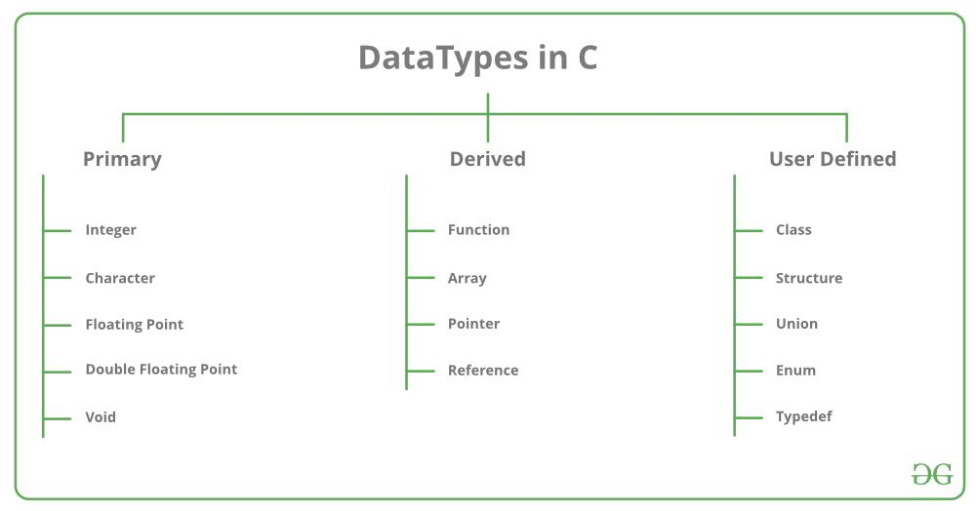

Slide 13
Data Type | Size (bytes) | Range | Format Specifier
short int | 2 | -32,768 to 32,767 | %hd
unsigned short int | 2 | 0 to 65,535 | %hu
unsigned int | 4 | 0 to 4,294,967,295 | %u
int | 4 | -2,147,483,648 to 2,147,483,647 | %d
long int | 4 | -2,147,483,648 to 2,147,483,647 | %ld
unsigned long int | 4 | 0 to 4,294,967,295 | %lu
long long int | 8 | -(2^63) to (2^63)-1 | %lld
unsigned long long int | 8 | 0 to 18,446,744,073,709,551,615 | %llu
signed char | 1 | -128 to 127 | %c
unsigned char | 1 | 0 to 255 | %c
float | 4 | 1.2E-38 to 3.4E+38 | %f
double | 8 | 1.7E-308 to 1.7E+308 | %lf
long double | 16 | 3.4E-4932 to 1.1E+4932 | %Lf

